Slide 1


CONNECT
(better)

Slide 2
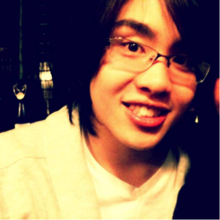
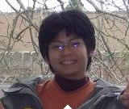
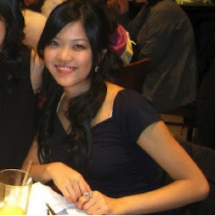

Who We Are
Evan Louie
Weifon Liu
Jeff Chan
Sandy Fang
Socially Awkward Penguins
(Nebulung)

Slide 3

What is Connect?
Course Management Tool
Aimed at professors and students to enable:
Collaboration
Online Quiz
Announcement

Slide 4
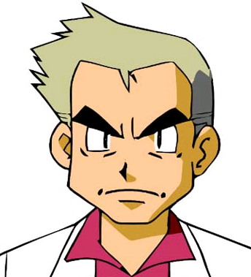


Stakeholders
STUDENTS
TA
Professor

Slide 5
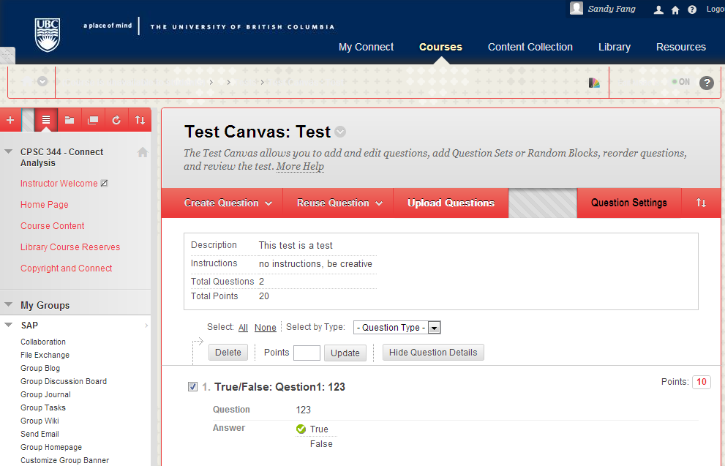
Problems
Cluttered UI
Difficult to Navigate
Cannot Inherit Content
Difficult to edit quizzes
No File Sharing or Group Management

Slide 6
Problems
Cluttered UI
Difficult to Navigate
Cannot Inherit Content
Difficult to edit quizzes
No File Sharing or Group Management

Slide 7

Goals
A UNIFIED course management tool which fulfills the needs of all users

Slide 8
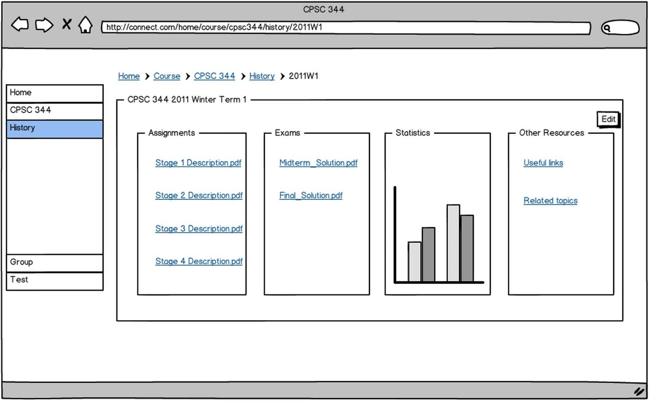
Low-fi ProtoType

Slide 9
Low-fi ProtoType
Cognitive Walkthrough:
We found that we need:
a more reduced and minimal UI
Easier navigation of functionality
Reduce the number of steps

Slide 10
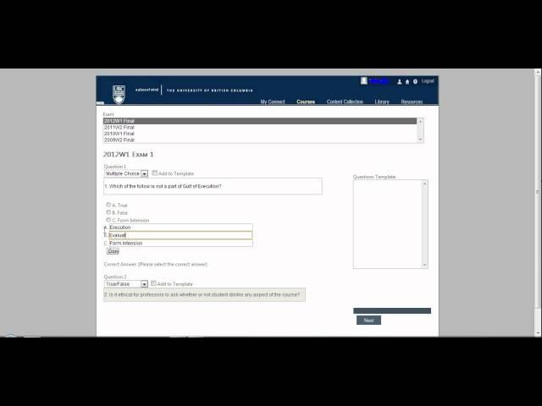
Med-Fi Demo

Slide 11
User Feedback
Observational walkthrough and post task semi-structured interview
2 Professors, 5 TAs, 1 Student.

Slide 12
User Feedback
Inheritance
Ease of use 8/8
Suggested Confirmation Box 2/8

Slide 13
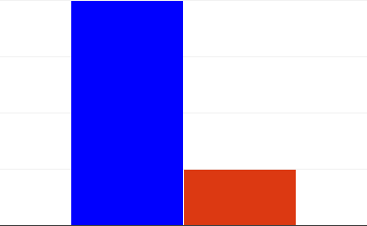
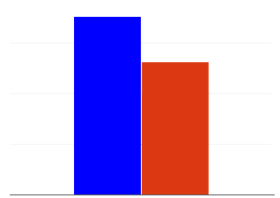
User Feedback
Exam Adoption
Requested for More Instructions 7/8
Reduced Number of...
75%
25%
Pages
Clicks

Slide 14
User Feedback
Group Management
Like Layout & Idea of Grouping 4/4
Requested for More Instruction 2/4

Slide 15
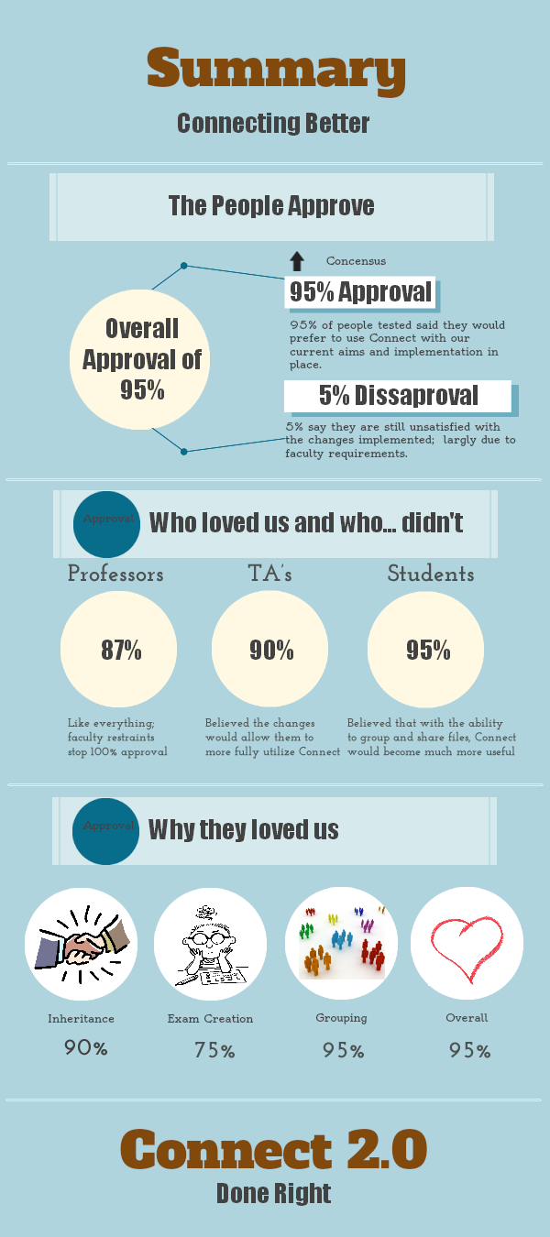

Slide 16
Reference
[1]:http://www.flickr.com/photos/heatsink/110859301/
[2] http://www.modspace.com/fileadmin/Media/images/mobile_offices/classrooms/daycare-rendering.jpg

Slide 17
Analysis
Inheritance:
Make system status more visible
Test Creation:
More Straightforward Layout Optimization of Workflow
Grouping:
Better labelling of content

Slide 18
Page To be deleted
What final result did you achieve, what is its principal value, and how is this value
substantiated by your user-centered process?
• What was the turning point / defining discovery for your team? Learnings?
• What are you most proud / excited about?
• You probably will want to show a demo. Think strategically about where & how much.

